Slide 1
Intro to HTML & CSS
EXPLORING THE FOUNDATION BEHIND THE WEBSITE, HTML, AND THE ADDITIONAL EDITING CAPABILITIES PRESENT IN CSS

Slide 2
What is HTML and CSS?
HTML – HYPER TEXT MARKUP LANGUAGE
- THE FOUNDATION OF WEBSITE ARE BASED FROM
CSS – CASCADE STYLE SHEET
- THE DESIGN STRUCTURE OF A WEBSITE
Notes:
E.A

Slide 3
HTML

Slide 4
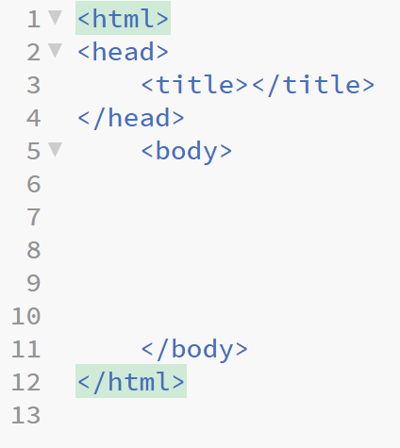
How to Start a HTML Webpage
The html tag is
the tag that encloses your code
The header tag
contains code that lets the browser know how to display a webpage
The body tag is
simply the content of your website
Notes:
E.A

Slide 5
HTML Text
<h1-7>
Header tags, used for heading a section
<p>
Paragraph tags, used for content in a section
<br />
Break tags easy way to put spaces in the page
Notes:
E.A

Slide 6
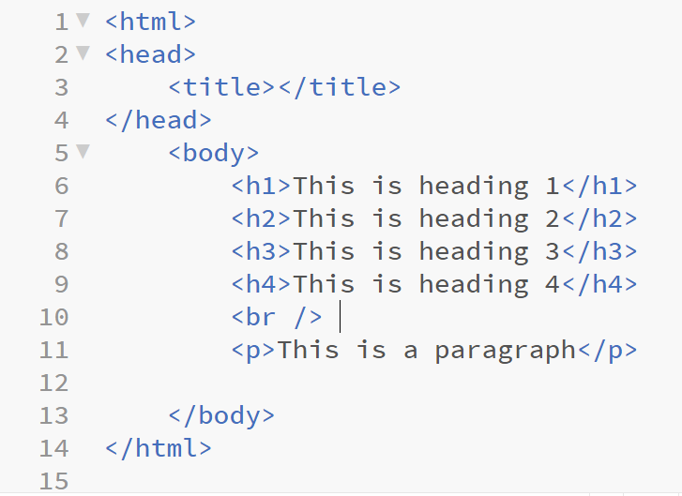
Notes:
E.A

Slide 7
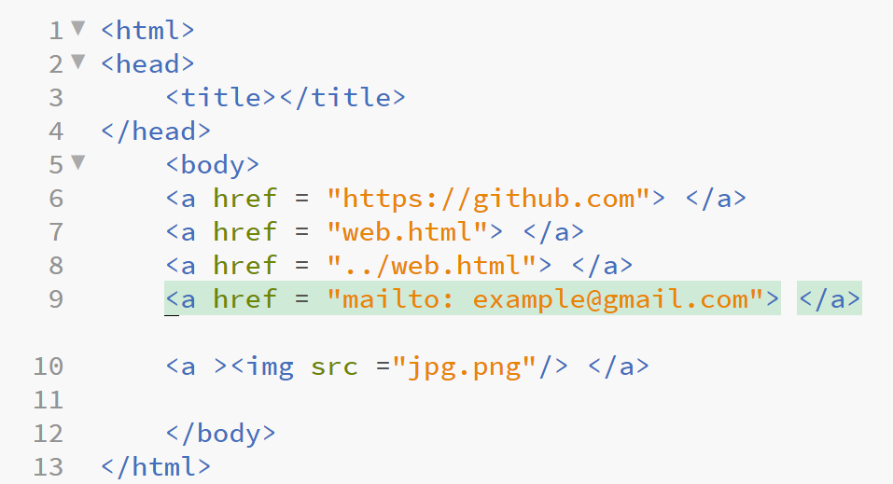
HTML Links
<a >
The tag that makes links to other websites
Notes:
O.M

Slide 8
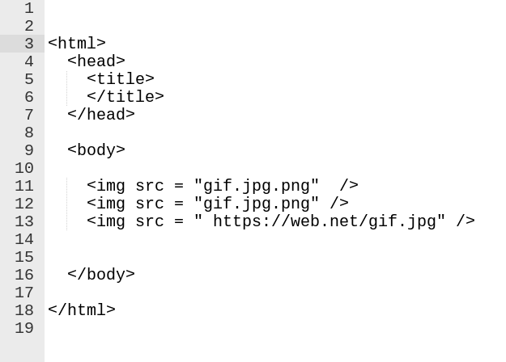
HTML Images
Notes:
E.A

Slide 9
CSS

Slide 10
CSS Applied
There are several ways to incorporate css into your webpage:
1. In line
<[tag] style = ";">
2. Internal using own element (used in head element)
<style type = "text/css">
3. make a .css file
in html
<link rel="stylesheet" type="text/css" href="style/style.css" />
Notes:
E.A

Slide 11
ID and classes
generally the same thing
what they do is hold a group of style arguments to be applied to an element
call = <[tag] id =”id” class = “class”> <[tag]>
#id { .class {
-CSS attributes -CSS attributes
-CSS attributes -CSS attributes
-CSS attributes -CSS attributes
} }

Slide 12
Link states
They are a thing of their own
and you can specify what happens to them
[tag ] : unvisited (default)
link
visited
hover

Slide 13
Color
color:
#ff0000;
red;
rgba(x,y,z,w); -a is for dimness
http://www.color-hex.com/

Slide 14
Background
background represents the whole html page
background-color same as color,
Working with a backdrop
background-image: url("gif.jpg.png");
Notes:
E.A

Slide 15
THE DIFFERENCE BETWEEN FONT AND TEXT
Who can give the difference between font and text?
Font edits the actual word
Text edits the dec
Font
Text

Slide 16
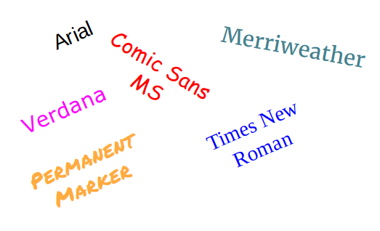
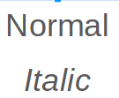
Font
The powerful about CSS is the font-family property
Then you can adjust it
Notes:
E.A

Slide 17
Text
This includes
Where it is positioned on the webpage
Text Indentation
Additional decoration to the text
How many spaces in between characters
Notes:
E.A

Slide 18
Shape Editing
Postition
absolute, relative
Dimensions
Height, Width, Z-index
top
left
right
bottom

Slide 19
Box Model
Border - Defines how thin or thick is the desired area of coverage.
As well as if it is solid, dashed or dotted.
Margin - Defines the distance of your content. Format is as follows:
margin-top, right, bottom, left (or clockwise).
Padding - Used to generate space around content. Similar format
as margin: padding-top, right, bottom, left.
Notes:
E.A

